Slide 1

Weather Forecasting with Data Analysis
By Dante Lozano Perez

Slide 2


Weather App
App has been developed using a python library called PyQt6 for a easy and visually responsive interface. Project integrates standard libraries to deliver a easy and practical weather experience
PyQt6 Created a user interface
Requests facilitating fetching real-time weather data from OpenWeather API
Date Time and Timedelta: Manage precise date and time calculations
Numpy and LinearRegression : providing the use of linear regression to predict the future weather trends

Slide 3
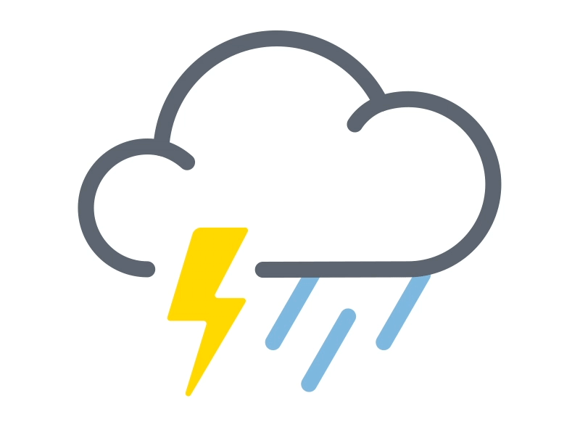

API Variations
Openweather has many options in their weather information, from which 3 different one’s were used in order to test and develop the use of the app. The first one presents the current weather conditions, the second one provides the current weather conditions plus 5 day precalculated forecast from API and the third one the recollection of historical data, do linear regression for the 5 most recent days and predict the upcoming 5 day forecast.
The first one presents the current weather conditions.
The second one provides the current weather conditions plus 5 day precalculated forecast from API.
The third one the recollection of historical data, do linear regression for the 5 most recent days and predict the upcoming 5 day forecast.

Slide 4
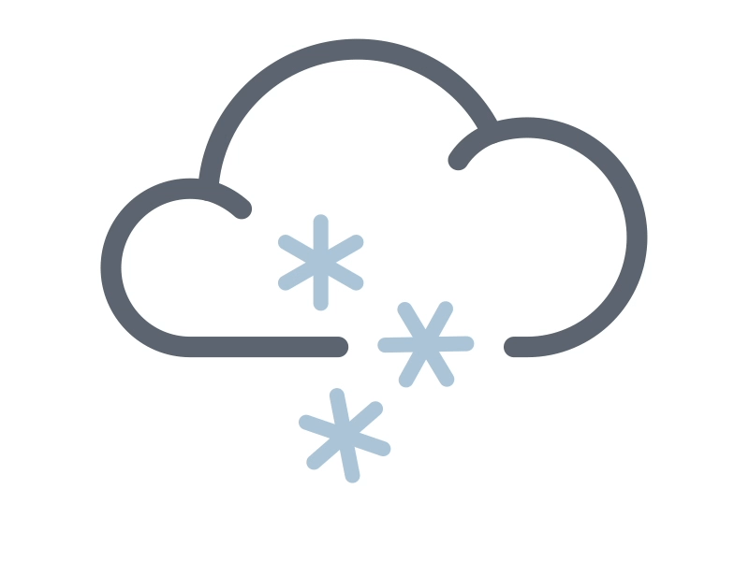
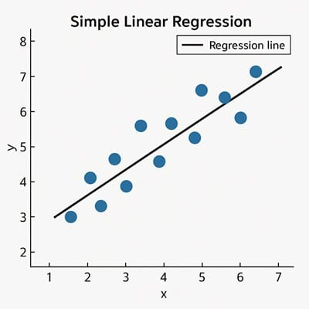
Regression in action
Version 3 of the application employs linear regression analyze the API data, offering a 5-day temperature prediction.
Historical Data Collection
App collects past temperature data using historical wather API
Data Structure with NumPy
Numpy arrays the collected data for analysis
Modeling with LinearRegression
Predict future temperatures
Model identifies the temperature trends
Based on model used, app predicts the upcoming 5 day’s temperatures, adding value to the app.

Slide 5
START
Create GUI
User may search again another city
User Enters City
Run Weather_Search()
Get info from API
Any Error code
Code 200
Pull info from past 5 days.
Display error
End Weather_Search()
Run Regression and predict forecast
Display Information
End when Click exit

Slide 6
Future Improvements
Create database
(Download info from API)
Limit cities
(Less cities May improve speed and discrepancies)
Implement time series analysis.
(Better forecast, precise and know weather conditions)

